Slide 1

To Do List
Desktop Application
By Pavel Isupov

Slide 2

Features
Authentication and Sign Up
Responsive design
Submit and Store task
Update and delete existing task
Task stores with unique user ID in the Database

Slide 3

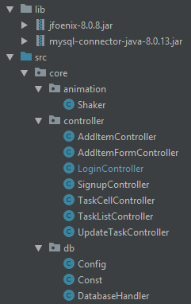
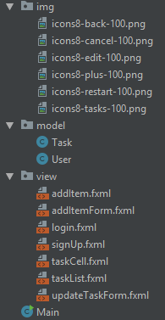
Code Structure

Slide 4
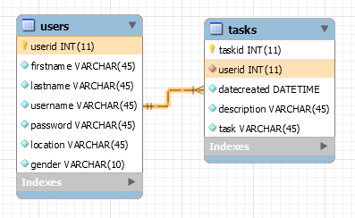
DB Structure

Slide 5






Technologies

Slide 6
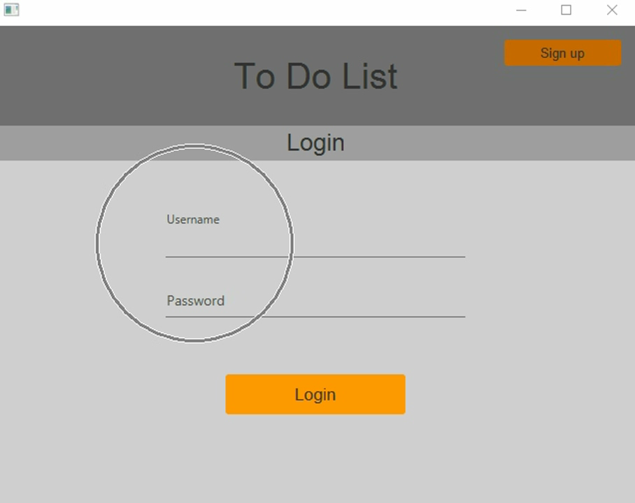
Application demo

Slide 7

Thank you
Questions?

